Slide 1
A Simple Network Approach to Ranking Athletic Teams
Andrew Lee Doug Shier
Industrial Engineering Mathematical Sciences
NC State University Clemson University

Slide 2
Overview
Rankings in sports
Analytic methods
  advantages and disadvantages
Proposed method
  visual representation
  minimal assumptions
Numerical examples
  small cases
  acyclic networks
  NCAA Division 1-A Football

Slide 3
Rankings in Sports
Determination of national champions
Selection for postseason play
Affects byes, matchups in tournaments
Problem of “pairwise comparisons”
  many teams, few observations
  unlike round robin play
  extraleague games

Slide 4
Analytic Methods
w_{i} = number of wins of team i
l_{i} = number of losses of team i
n_{i} = w_{i} + l_{i} = number of games played by team i
w_{ij} = number of wins of team i over of team j
l_{ij} = number of losses of team i to team j
n_{ij} = w_{ij} + l_{ij} = games played between i and j

Slide 5
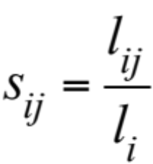
Analytic Methods
Markov Method
Solve rS = λr, where S = (s_{ij}) is row stochastic:
– requires S to be irreducible; then r > 0 is the
eigenvector corresponding to λ = 1
What if a team is undefeated?

Slide 6
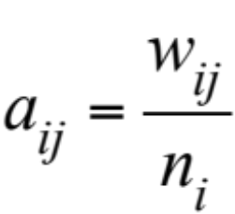
Analytic Methods
Keener’s Method
Solve Ar = λr, where A = (a_{ij}) is not stochastic:
– requires A to be irreducible; if A is primitive can
apply the Power Method to compute r

Slide 7
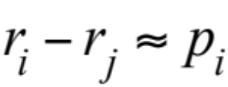
Analytic Methods
Massey’s Method
Use linear model to approximate point spreads p_{i}
Solve Mr = p, where m_{ij} = –n_{ij} and m_{ii} = n_{i}
– requires game statistics (point spreads)
Keener can also use game statistics

Slide 8
Formulation of a Simple Model
Guiding Principle 1: Use only pairwise comparisons (flexible)
graphical representation: (i, j ) indicates that team i beat team j
Guiding Principle 2: A team is only as good as the teams it beats
i.e., measure the strength of a team by the strengths of the teams it beats
⇒ consider first-level, second-level, third-level, … victories

Slide 9
Graphical Representation
a
x
b
c

Slide 10
Graphical Representation
a
x
first-level victories
b
c

Slide 11
Graphical Representation
a
x
second-level victories
b
c

Slide 12
Who is Stronger?
a
a
u
x
b
v
z
b
c
c
u seems a stronger team than v

Slide 13
Who is Stronger?
a
a
u
x
b
v
z
b
c
c
x has only beaten weak teams, but z has beaten strong teams

Slide 14
The Many Levels of Victories
…
Paths of different lengths from node u
u
Level 1
2
3

Slide 15
The Issue of Cycles
Life is not transitive!
x
u
a
c
cycle [a, b, c, a]
b
Team u should get credit for the two-level path [u, a, x]

Slide 16
The Issue of Cycles
Life is not transitive!
x
u
a
c
b
simple path
Team u should get credit for the two-level path [u, a, x] but not for the five-level path [u, a, b, c, a, x].

Slide 17
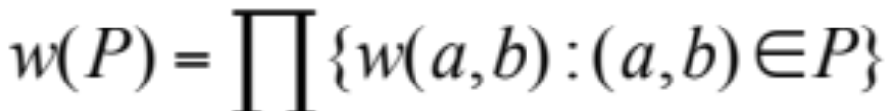
Proposed Model
Suppose we specify weights w(a, b) for each arc (a, b) in the graphical representation.
Then the weight w(P) of path P is defined as the product of the constituent arc weights:
w₁
w₂
w₃
w₄
x
a
b
c
d
w(P) = w₁w₂w₃w₄

Slide 18
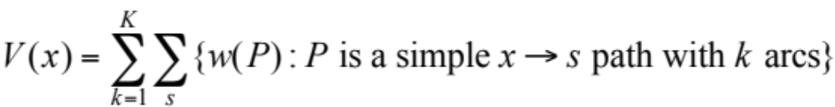
Proposed Model
Fix a value K = maximum level for paths.
For node (team) x we define its strength V(x) by adding up w(P) for all simple paths P starting at x of length ≤ K:
But how do we define the weight w(a,b) of arcs?

Slide 19
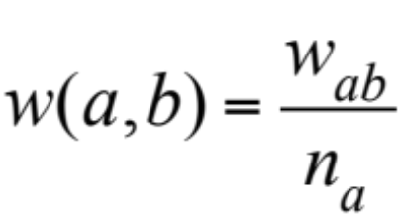
Arc Weights
We define the weight of arc (a, b) using the reciprocal of the number of games played by team a:
x
¼
/
1
Here the first-level points for team a is then ¾ = 0.750, the winning percentage for team a
3
¼
/
1
3
u
a
c
/
¼
1
2
b
“normalization”

Slide 20
Example
a
each team plays 3 games
f
b
e
c
all arcs have weight 1/3
d

Slide 21
Example
a
all arcs have weight 1/3
f
b
e
c
d
Team a: 2(1/3)

Slide 22
Example
a
all arcs have weight 1/3
f
b
e
c
d
Team a: 2(1/3) + 1(1/3)² = 7/9

Slide 23
Example
a
all arcs have weight 1/3
f
b
e
c
d
Team b: 3(1/3)

Slide 24
Example
a
all arcs have weight 1/3
f
b
e
c
d
Team b: 3(1/3) + 3(1/9)

Slide 25
Example
a
all arcs have weight 1/3
f
b
e
c
d
Team b: 3(1/3) + 3(1/9) + 2(1/27)

Slide 26
Example
a
all arcs have weight 1/3
f
b
e
c
d
Team b: 3(1/3) + 3(1/9) + 2(1/27) + 3(1/81) = 117/81

Slide 27
Example
a
all arcs have weight 1/3
f
b
e
c
d
team | a | b | c | d | e | f
V(x) | 0.78 | 1.44 | 0 | 0.48 | 0.85 | 0.56
ranking: b > e > a > f > d > c

Slide 28
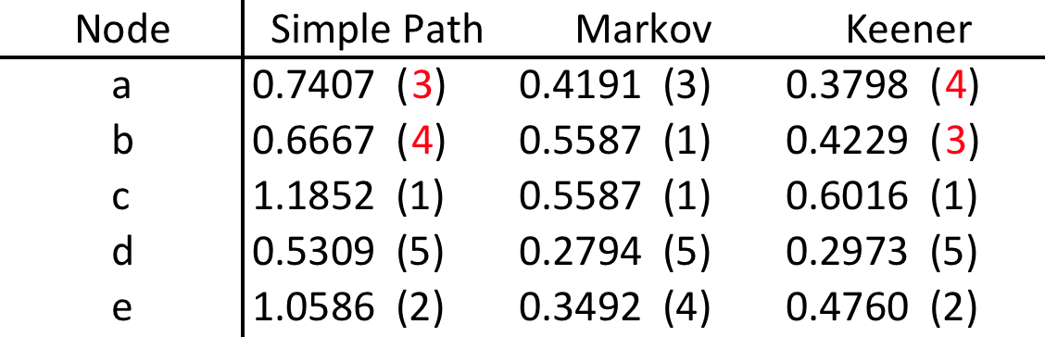
Example 1
a
b
c
e
d
– Matrix A is primitive and irreducible.
– Team a beats team b, and has a higher win %, so should be
ranked higher.

Slide 29
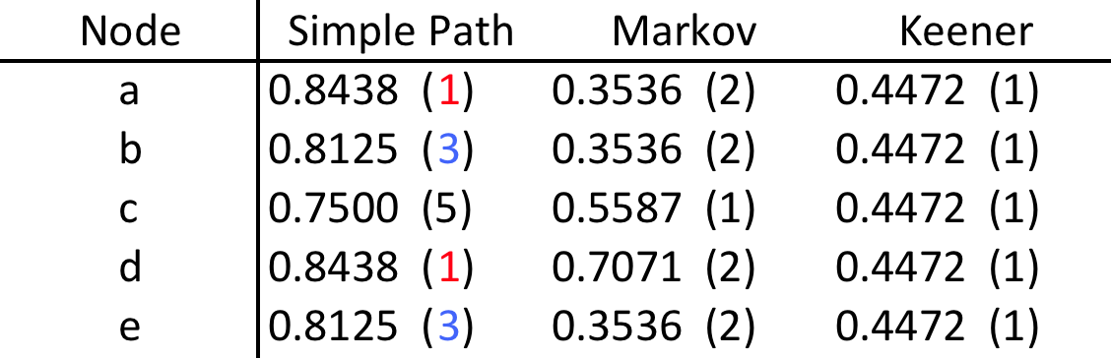
Example 2
a
b
c
e
d
– Matrix A is irreducible but not primitive; Keener not informative.
– All teams have the same win %.
– Simple Path distinguishes between a/d and b/e; it ranks c last.

Slide 30
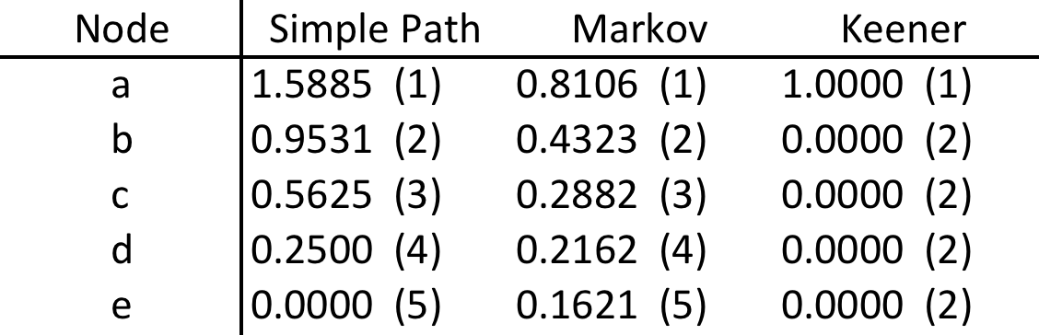
Example 3
a
b
c
d
e
– Graph is acyclic with topological order a > b > c > d > e.
– Matrix A is reducible.

Slide 31
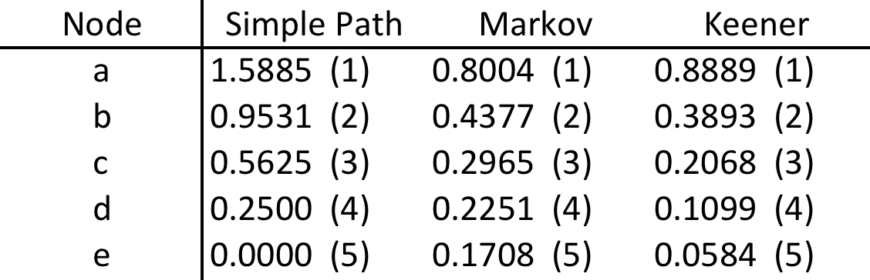
Example 3⁺
a
b
c
d
e
– Add a small perturbation to each entry to make A irreducible
and primitive.
– Keener now gives meaningful results.

Slide 32
Complete Acyclic Graphs
4
3
2
Unique topological order 4 > 3 > 2 > 1; all arcs have value α = 1/(n – 1)
1
Let f_{k} = rating value of node k. Develop recursion
f_{k} = α [f_{k–1} + f_{k–2} + … + f₁] + (k – 1) α, f₁ = 0

Slide 33
Complete Acyclic Graphs
f_{k} = α [f_{k–1} + f_{k–2} + … + f₁] + (k – 1) α, f₁ = 0
= α [(f_{k–1} + 1) + (f_{k–2} + 1) + … + (f₁ + 1)], f₁ = 0
Let g_{k} = f_{k} + 1
g_{k} = α [g_{k–1} + g_{k–2} + … + g₁] + 1, g₁ = 1
g_{k} = (1 + α) ^{k–1}, so f_{k} = [n/(n – 1)] ^{k–1} – 1

Slide 34
General Acyclic Graphs
g₁ = 1
1/3
5
g₂ = (1/4)g₁ + 1 = 5/4
4
3
2
g₃ = (1/4)g₁ + (1/4)g₂ + 1 = 25/16
1/4
g₄ = (1/4)g₁ + (1/4)g₂ + (1/4)g₃ + 1 = 125/64
1
g₅ = (1/3)g₂ + (1/3)g₃ + (1/3)g₄ + 1 = 497/192

Slide 35
General Acyclic Graphs
In general, solve g = Ag + e, where e = (1, 1, …, 1)^{T} and A = (a_{ij}) is the Keener matrix
Then f = g – 1 gives the simple path rating vector.
Solve Ar = λr

Slide 36
Generating Simple Paths
a
b
f
b
c
d
e
1/3
e
c
f
f
c
1/9
a
a
1/27
d
c
c
d
1/81
all arcs have weight 1/3

Slide 37
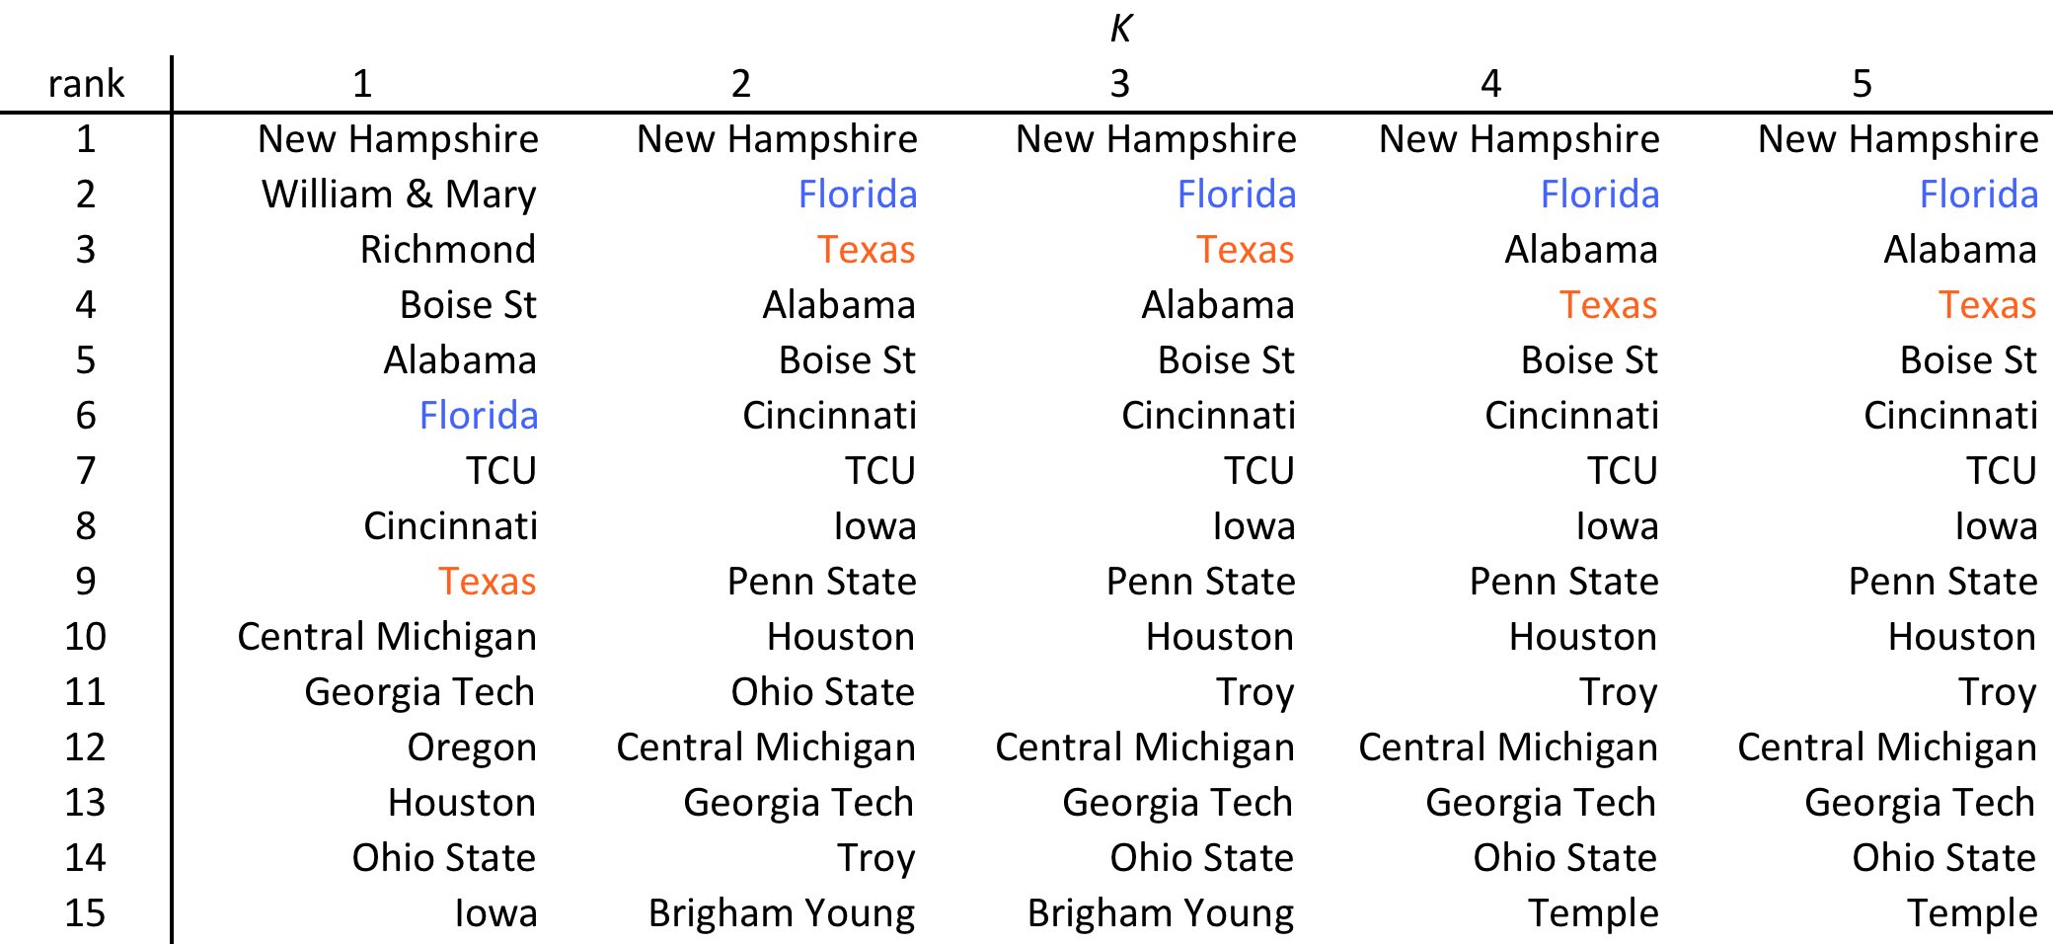
NCAA Football 2009, Week 14
– Convergence generally achieved using a value of K = 4 or K = 5.

Slide 38
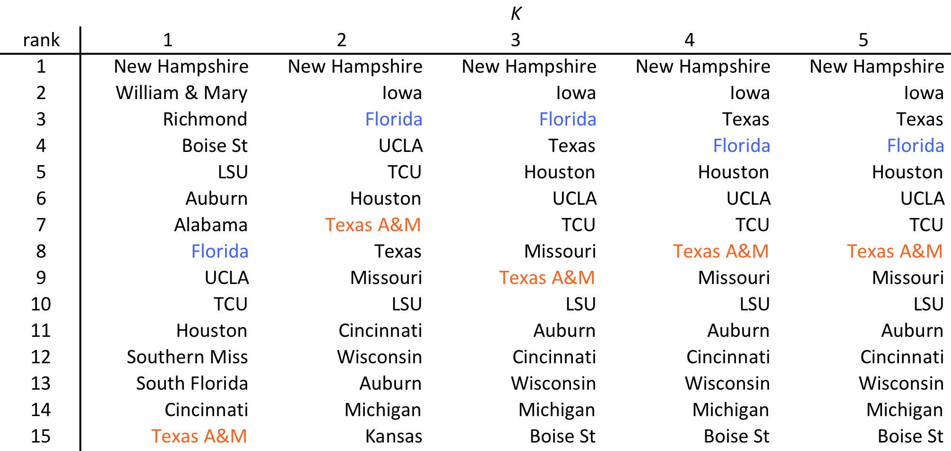
NCAA Football 2009, Week 4
– Meaningful results obtained even early in the season.

Slide 39
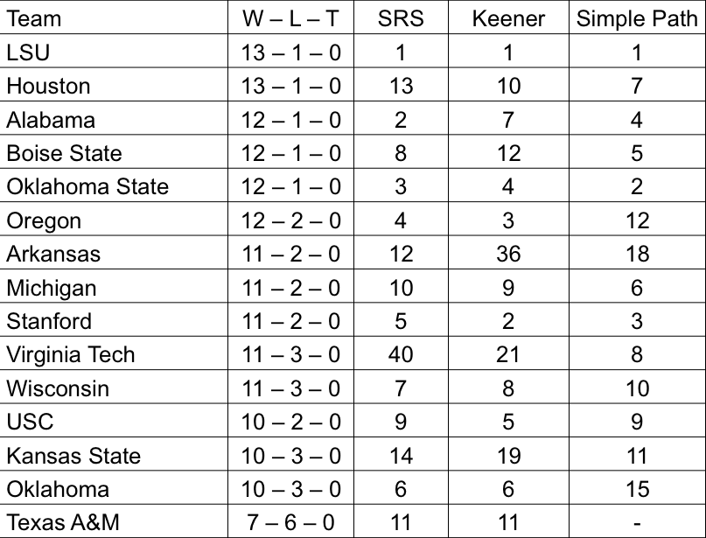
NCAA Football 2011, Final Rankings

Slide 40
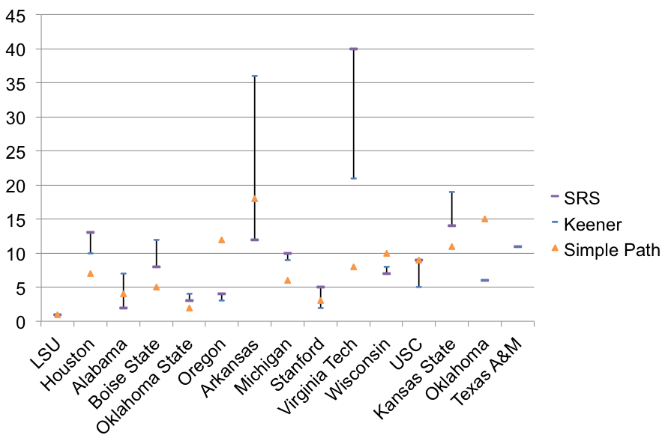
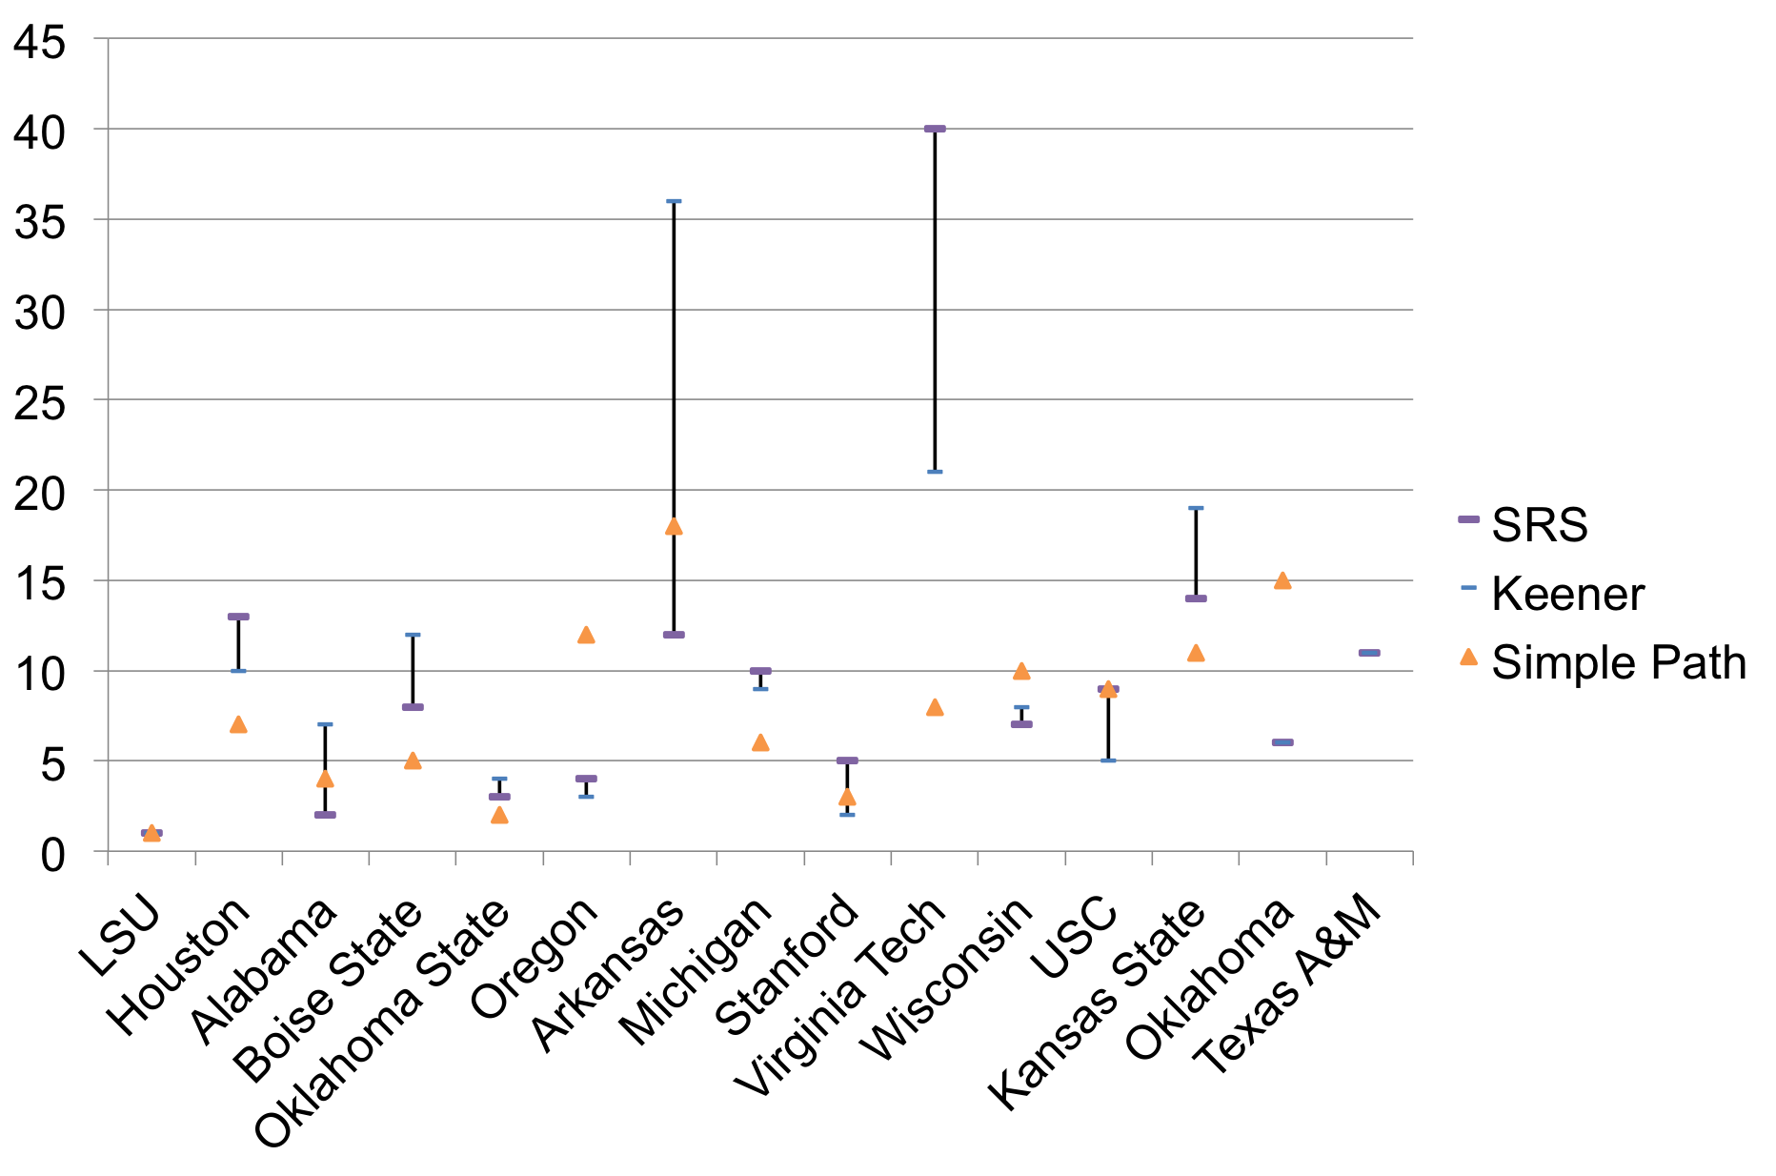
NCAA Football 2011, Final Rankings

Slide 41
Application: Ranking Proposals
A panel with 9 members is charged with the task of ranking 6 research proposals. It is not practical for each member to read all 6 proposals.
Instead each member provides a head-to-head comparison of two of the proposals.
preferred
judge | 1 | 2 | 3 | 4 | 5 | 6 | 7 | 8 | 9
proposal 1 | b | a | f | a | b | d | b | e | e
proposal 2 | c | d | a | c | d | f | e | f | c

Slide 42
a
f
b
e
c
d
judge | 1 | 2 | 3 | 4 | 5 | 6 | 7 | 8 | 9
proposal 1 | b | a | f | a | b | d | b | e | e
proposal 2 | c | d | a | c | d | f | e | f | c
ranking: b > e > a > f > d > c

Slide 43
Summary
Analytic methods
  advantages and disadvantages
Proposed method
  visual representation
  uses simple paths
  minimal assumptions
  meaningful results early in season
Closed form solution for acyclic case
Numerical examples

Slide 45
Application: Page Rank
Suppose you enter a search term into your favorite search engine (such as GoogleTM).
Very quickly a list of web pages appears, ordered by their “relevance”.
How is this list produced? It is based on
• content score
• importance score
appearance of term
hyperlink structure

Slide 46
PageRank Algorithm
Developed in 1998 by Sergey Brin and Larry Page (founders of GoogleTM)
Treats web as a (huge) graph with nodes ~ pages and arcs indicating hyperlinks (“recommendations”)
Two considerations
• stature of the recommender (authority)
• # of pages recommended by the authority
V(x)
1/g⁺
outdegree

Slide 47
PageRank Algorithm
“A web page is important if it is recommended by other important web pages”.
In essence, V(x) is defined as a weighted sum of the V(s) for all arcs (s, x) entering node x: the weights are the reciprocals of the outdegrees d⁺(s).
a
V(a)
1/d⁺(a)
V(x)
1/d⁺(b)
x
b
V(b)
1/d⁺(c)
c
V(c)

Slide 48
Overview
Uses of ranking in sports
Variety of methods
  statistical estimation
  optimization
Proposed method
  graphical representation
  based on (simple) paths
  desirable properties
Other ranking applications
  evaluating proposals
  GoogleTM PageRank

Slide 49
Possible Approaches
Rank teams on basis of number of wins
  works for baseball (equal number of games)
  in general need normalization factor
Determine rank by winning percentage
  not all wins are “equal”
  win over strong vs. weak opponent
National polls
  AP (sportswriters), UPI (coaches)
  subjective, prior expectations
Need for objective and robust methods

Slide 50
Analytic Methods
Assign point value V_{k} to team k
Use linear models to fit point spreads
V_{k} – V_{m} ≈ score_{km}
winning margin of Team k over Team m
Leake [1976], Harville [1977]

Slide 51
Analytic Methods
Assign point value V_{k} to team k
Use linear models to fit point spreads
V_{k} – V_{m} ≈ score_{km}
– Problem with intransitive relationships:
team a beats team b by s_{ab} points
team b beats team c by s_{bc} points
team c beats team a by s_{ca} points
– Running up the score

Slide 52
High School Football
Different numbers of points for victories over different classes of school:
e.g., A, B, C, D: 80, 64, 48, 32 points
Credit for victories by your defeated opponents
e.g., 8 points for each victory
Credit for victories of opponents beating you
e.g., 1 point for each victory
first-level points
second-level points
second-level points

Slide 53
Pros and Cons
+ Takes into account the relative strengths of opponents
+ Credit for first-level and second-level victories
– Teams might play different numbers of games
– Second-level points don’t adjust for school class
– Point assignments (80, 64, …) are arbitrary

